Slide 1

CLIPPERS POSITIONS Salary Observations: Side-by-Side Bar Graphs
Team 7
Project_1_Team_7/ClippersScripts_ha/Clippers_ha.ipynb

Slide 2
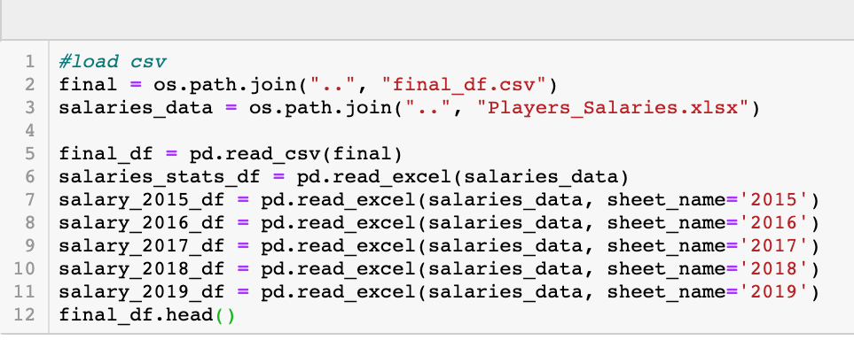
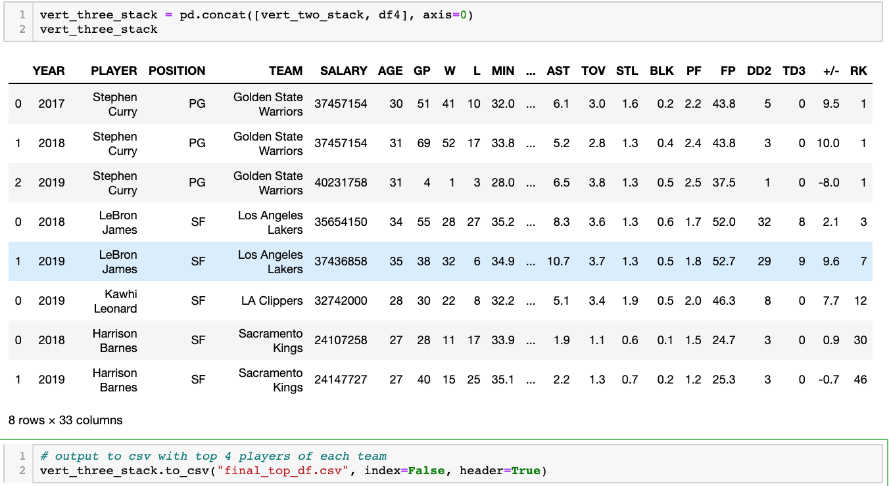
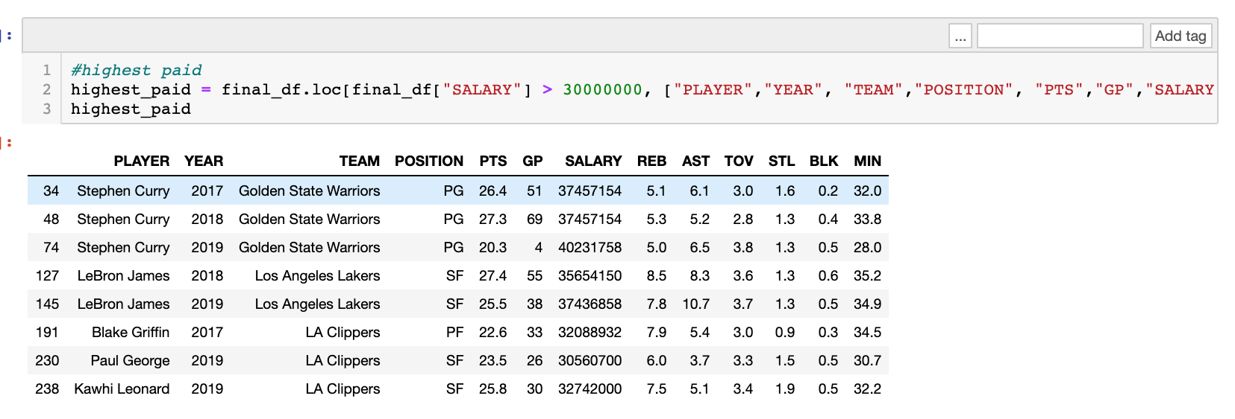
Data Cleaning Used
Loading CSV and multiple Excel Sheets
Concat Two DataFrames Into Single
.loc to search specific data

Slide 3
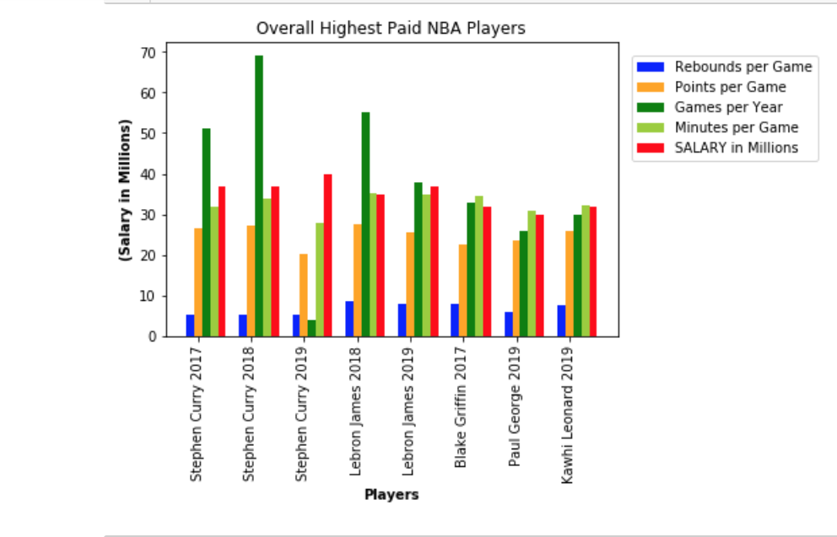
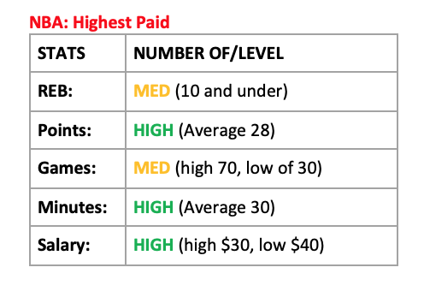
NBA: Overall Highest Paid

Slide 4
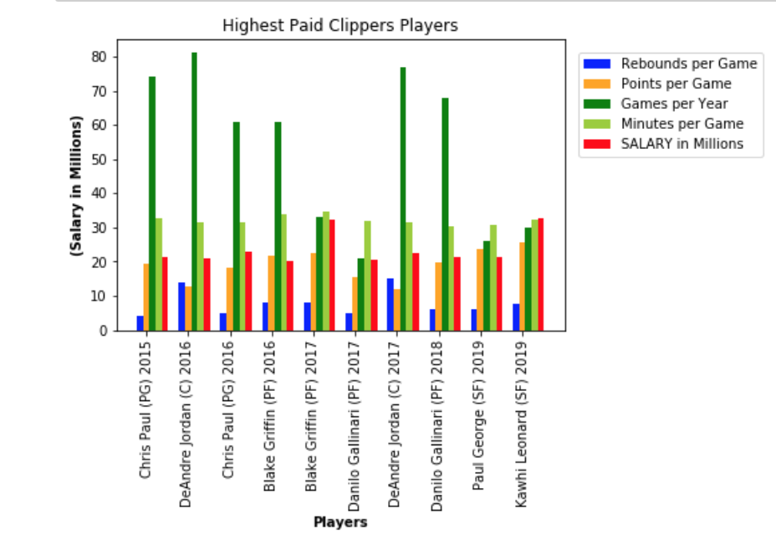
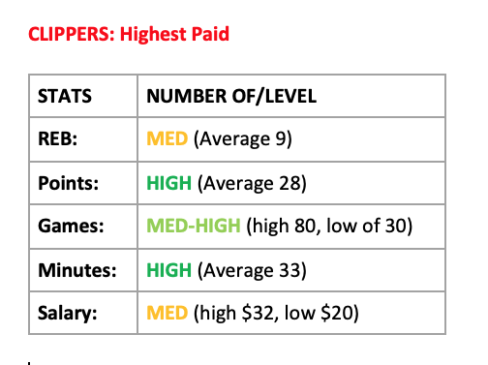
CLIPPERS: Highest Paid

Slide 5
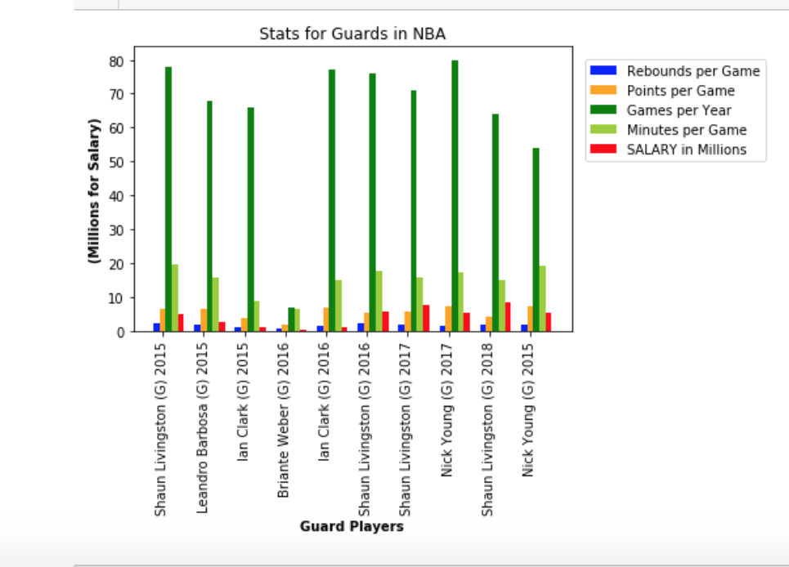
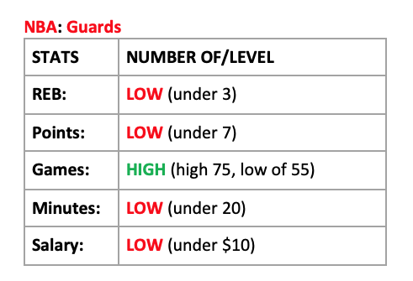
NBA: Guard Positions

Slide 6
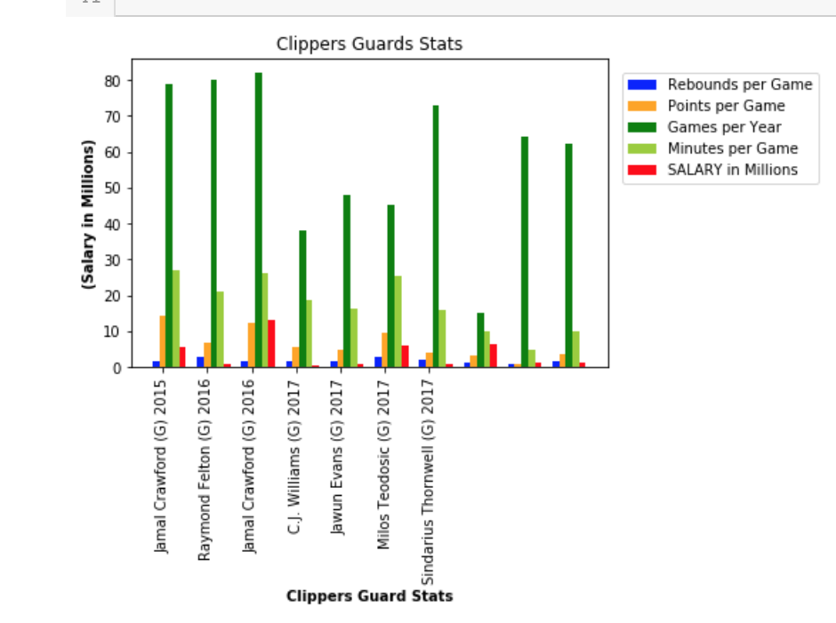
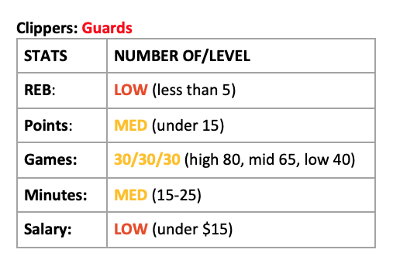
CLIPPERS: Guard Positions

Slide 7
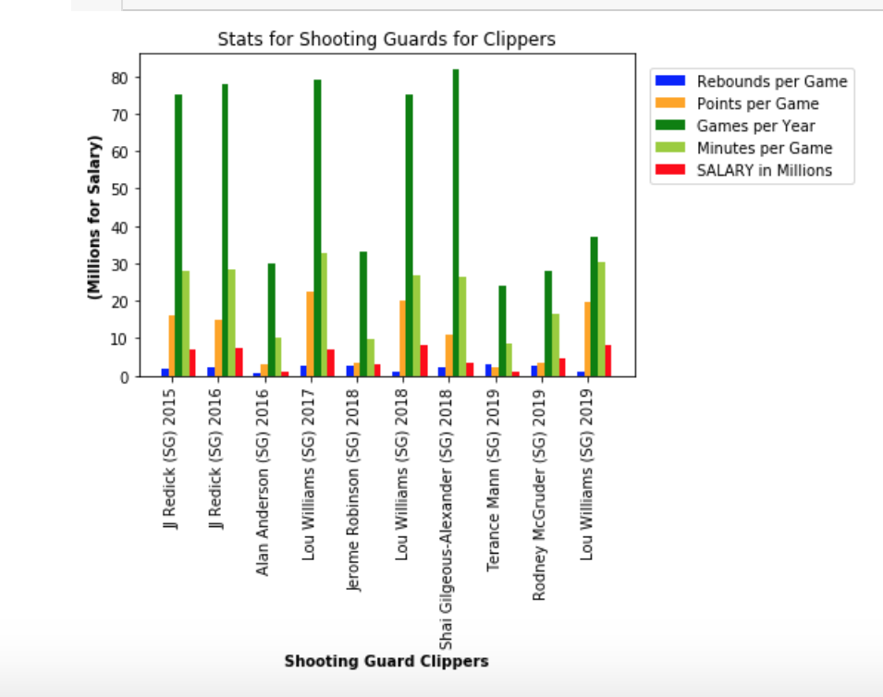
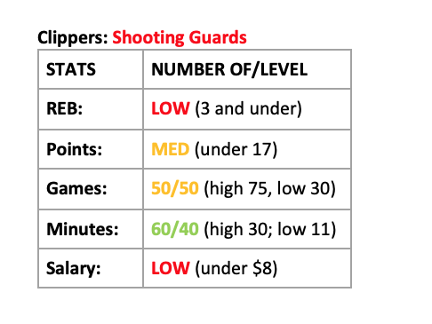
CLIPPERS: Shooting Guard Positions

Slide 8
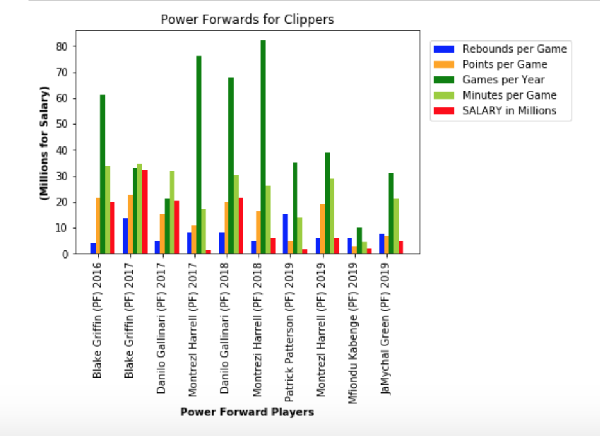
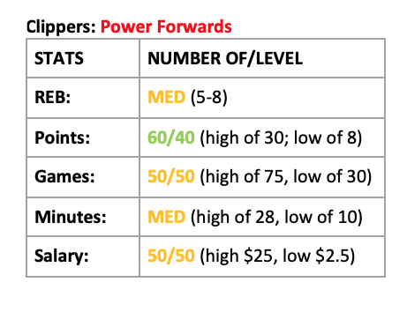
CLIPPERS: Power Forward Positions

Slide 9
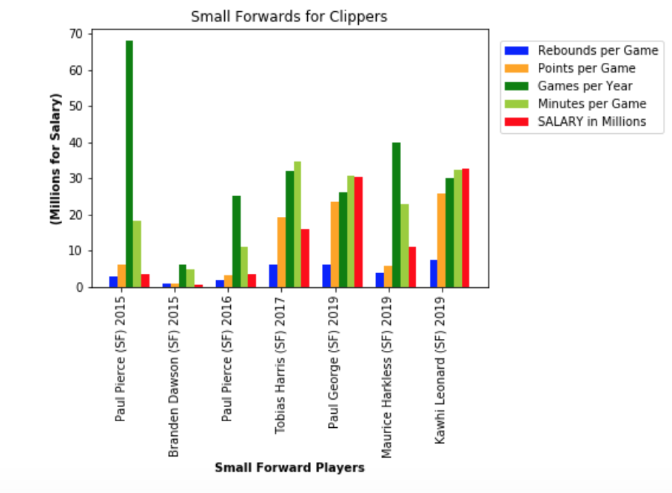
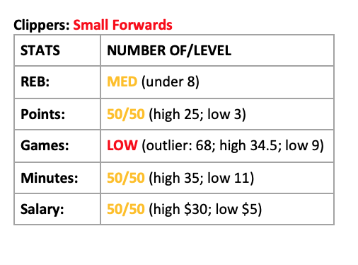
CLIPPERS: Small Forward Positions

Slide 10
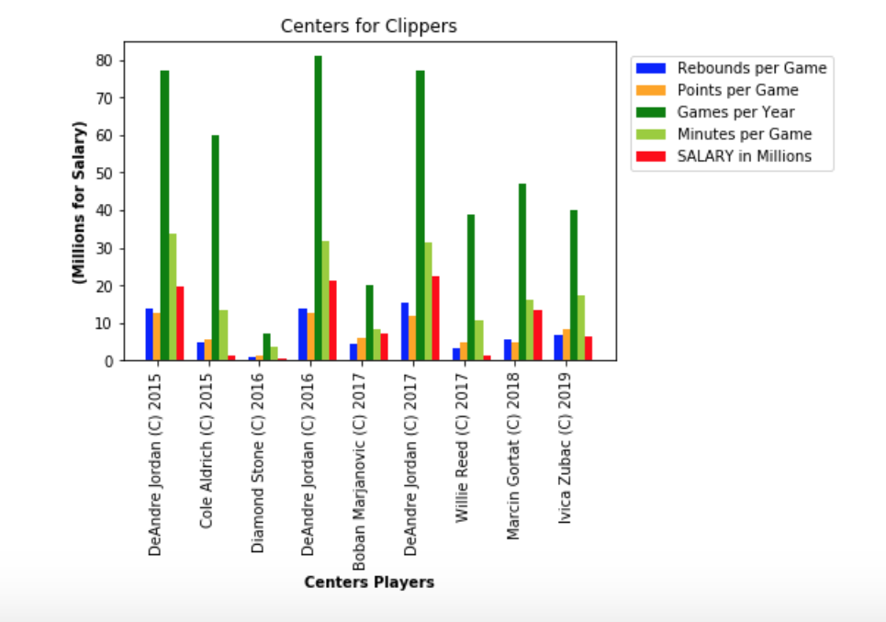
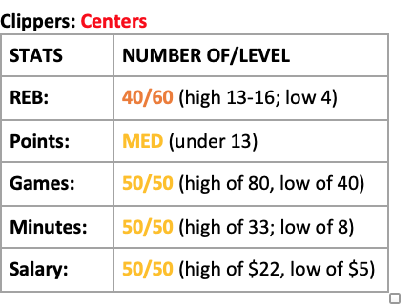
CLIPPERS: Center Positions

Slide 11
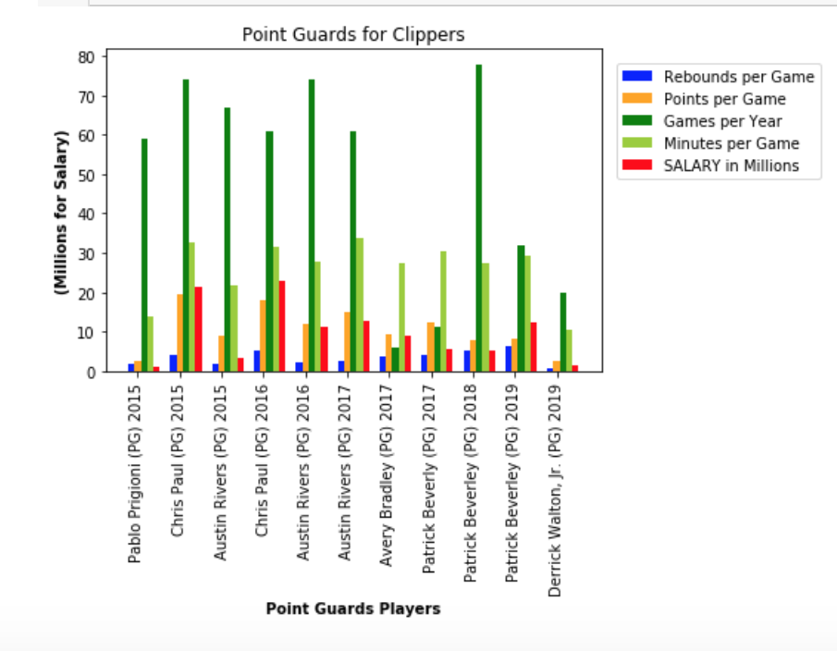
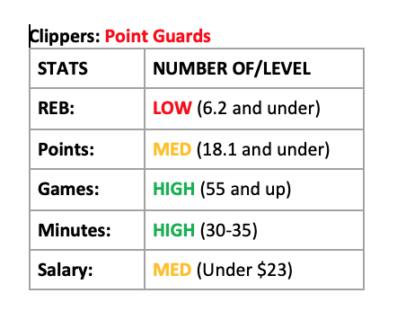
CLIPPERS: Point Guard Positions

Slide 12
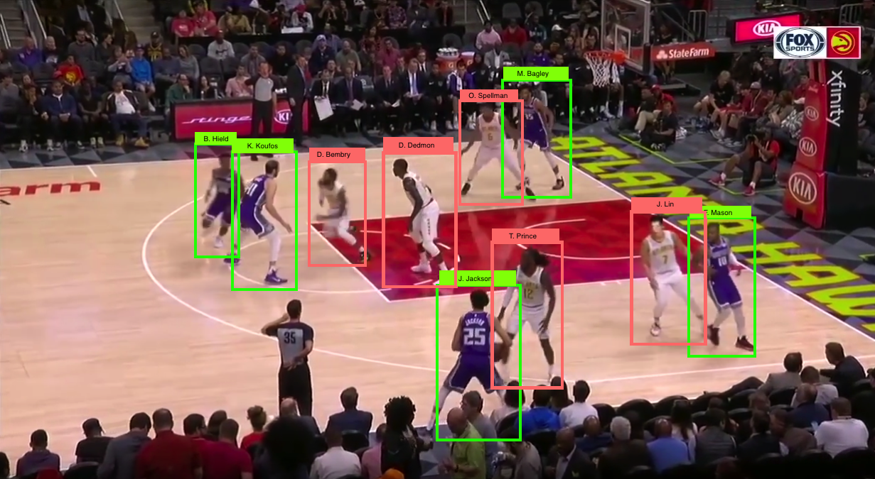
Summary Analysis: Trends and Limitations
Higher points per game seem to predict higher salaries.
Power Forwards and Small Forwards show higher salaries in this Data Analysis.
Limitations: data selection for this analysis was random, a more more specific group(ie: only top paid players) may have produced more clear results, too small data pool, lack strong calculated correlations.

